Slide 1
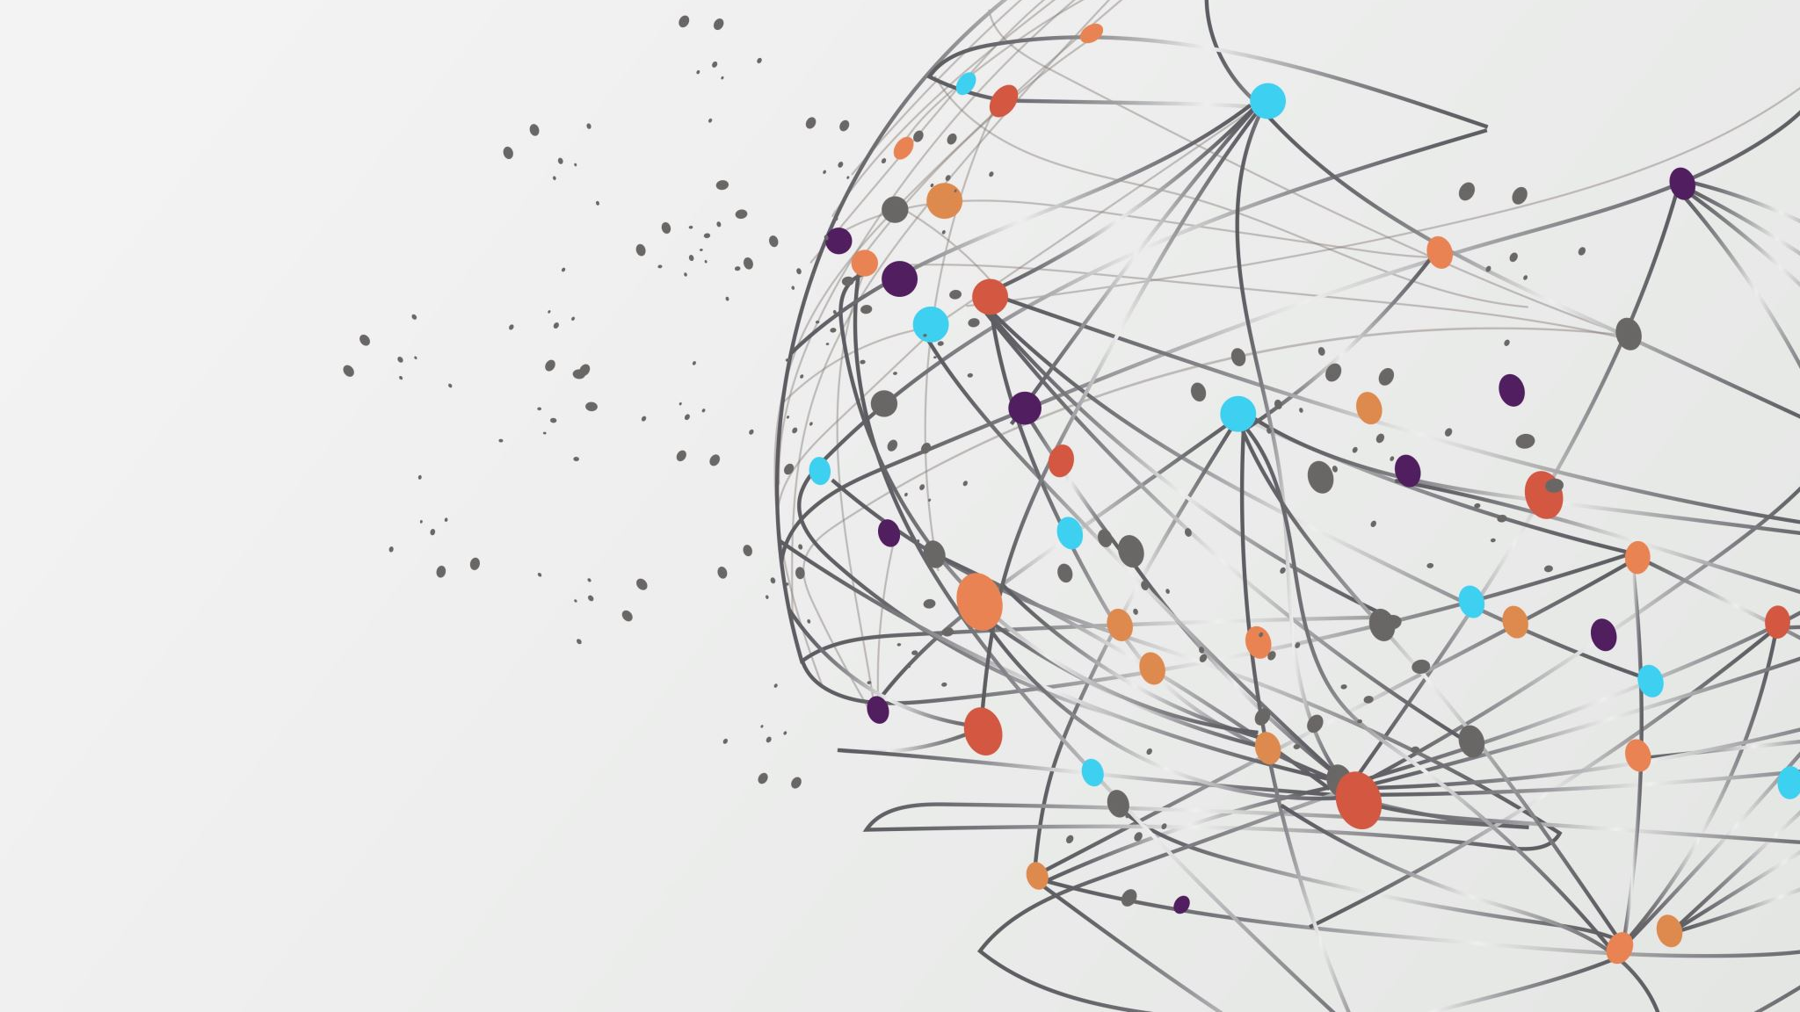
Understanding Agile
A Guide for Leadership
Andrew Cole

Slide 2
Introduction to Agile
Agile methodology is an iterative and flexible approach to software development that emphasizes adaptability, collaboration, and customer feedback.
In today's rapidly evolving digital landscape, Agile has become the preferred choice for many organizations due to its ability to deliver high-quality software solutions efficiently and effectively.
The Scrum-agile approach is a specific framework within Agile that provides a structured process for managing complex projects and delivering value to customers in short iterations or sprints.

Slide 3
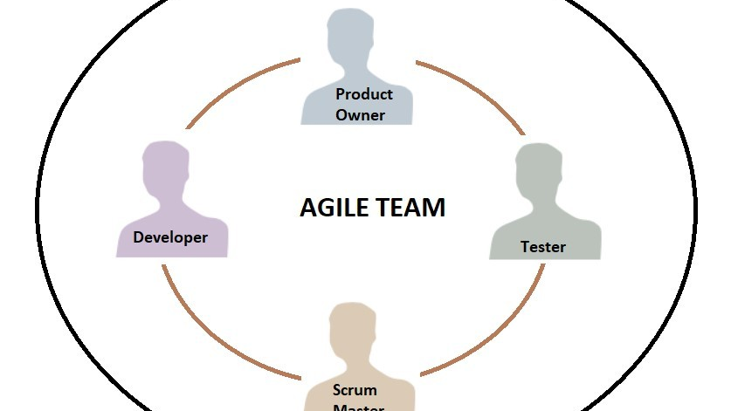
Roles in Scrum-agile Team
Scrum Master: Facilitates the Scrum process, ensures adherence to Scrum principles, removes obstacles, and fosters a collaborative team environment.
Product Owner: Represents the voice of the customer, defines project vision and priorities, manages the product backlog, and ensures alignment with stakeholders' needs.
Development Team: Cross-functional team responsible for delivering high-quality increments of work each sprint, self-organizing, and collaborating to meet sprint goals.
Tester: Ensures the quality and reliability of the software deliverables throughout the project. Collaborates closely with developers to validate user stories against defined acceptance criteria, conducts thorough testing to identify and report any defects or issues, and actively participates in sprint reviews to provide valuable feedback on completed user stories.

Slide 4
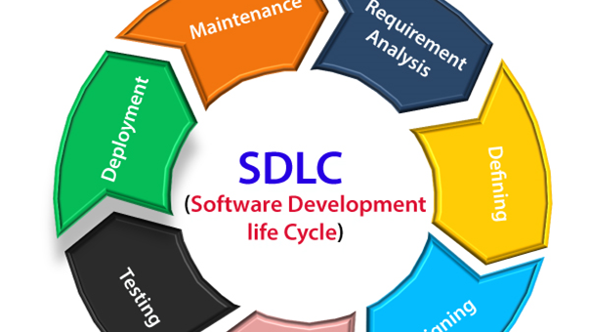
Phases of Software Development Life Cycle (SDLC)
Planning: Involves defining project scope, objectives, and requirements, as well as estimating resources, timelines, and risks. Planning sets the foundation for the entire development process.
Analysis: Focuses on gathering and analyzing user requirements, business processes, and system functionalities. It aims to understand the needs of stakeholders and define the system's specifications.
Design: In this phase, the system architecture, database design, and software specifications are created based on the requirements gathered in the analysis phase. It involves designing the overall structure and components of the software system.
Implementation (Coding): Developers write and test the code according to the design specifications. This phase involves translating the design into actual software components, modules, and functionalities.
Testing: The software undergoes various testing activities to identify and fix defects or bugs. Testing includes unit testing, integration testing, system testing, and user acceptance testing to ensure the software meets quality standards and user requirements.
Deployment (Installation): The software is deployed or installed in the production environment, making it accessible to end-users. This phase may involve activities such as data migration, user training, and deployment planning to ensure a smooth transition to the new system.
Maintenance: Once the software is deployed, it enters the maintenance phase, where updates, patches, and enhancements are made as needed to address issues, improve performance, or add new features. Maintenance ensures the long-term reliability and usability of the software system.

Slide 5

Contrast with Waterfall Approach
Waterfall Methodology: Sequential approach with distinct phases (e.g., requirements, design, implementation, testing) where each phase must be completed before moving to the next.
Contrast: Agile is iterative and allows for flexibility, while Waterfall follows a linear, predetermined path. Agile emphasizes customer collaboration and adaptability, whereas Waterfall focuses on comprehensive upfront planning and documentation.

Slide 6
Comparison: Waterfall vs. Agile
Project Complexity: Agile is better suited for complex and evolving projects, while Waterfall may be more suitable for straightforward, well-defined projects.
Client Requirements: Agile allows for continuous feedback and adjustments, making it ideal for clients with changing needs. Waterfall requires detailed upfront requirements.
Flexibility: Agile offers greater flexibility and responsiveness to change, while Waterfall is less adaptable once the project scope is defined.
Stakeholder Involvement: Agile encourages frequent collaboration and involvement of stakeholders throughout the project, whereas Waterfall typically involves stakeholders at the beginning and end of the project.

Slide 7
References
Thampy, R. (2022) 7 stages of SDLC: 7 phases of SDLC Software Development Life cycle, BETSOL. Available at: https://www.betsol.com/blog/7-stages-of-sdlc-how-to-keep-development-teams-running/ (Accessed: 21 April 2024).

